Slide 1
Analytical Chemistry 1st stage students Gravimetric analysis Lecture I by/ Dr. khawla salman

Slide 2
Gravimetric analysis
Gravimetric methods: The quantitative methods that are based on determining the mass of a pure compound to which the analyte is chemically related.
Types of Gravimetric Analysis
• Precipitation gravimetry: The analyte is separated from a solution of the sample as a precipitate and is converted to a compound of known composition that can be weighed.
• Volatilization gravimetry: The analyte is separated from other constituents of a sample by converting it to a gas of known chemical composition that can be weighed.
• Electrogravimetry: The analyte is separated by deposition on an electrode by an electrical current.

Slide 3
Steps in Gravimetric Analysis
1- Precipitation
2- Digestion
3- Filtration
4- Washing
5- Drying and igniting
6- Weighing
7- Calculation

Slide 4
Gravimetric analysis
Precipitation gravimetry
is an analytical technique that uses a precipitation reaction to separate ions from a solution. The chemical that is added to cause the precipitation is called the precipitant or precipitating agent. The solid precipitate can be separated from the liquid components using filtration, and the mass of the solid can be used along with the balanced chemical equation to calculate the amount or concentration of ionic compounds in solution. Sometimes you might hear people referring to precipitation gravimetry simply as gravimetric analysis, which is a broader class of analytical techniques that includes precipitation gravimetry and volatilization gravimetry
Analyt + precipitatiting agent precipitate
( reagent )

Slide 5
Precipitating reagents

Slide 6
Precipitating reagents

Slide 7
1- inorganic Precipitating reagents(agent)

Slide 8
inorganic Precipitating reagents

Slide 9
2- organic precipitation agents

Slide 10
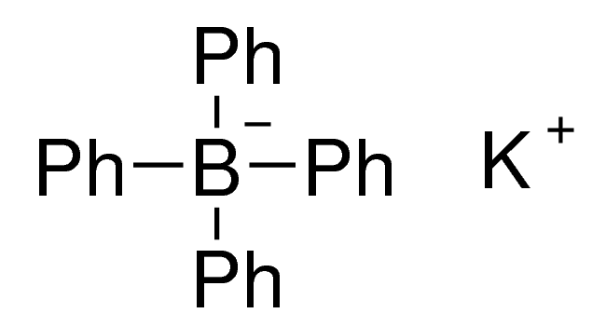
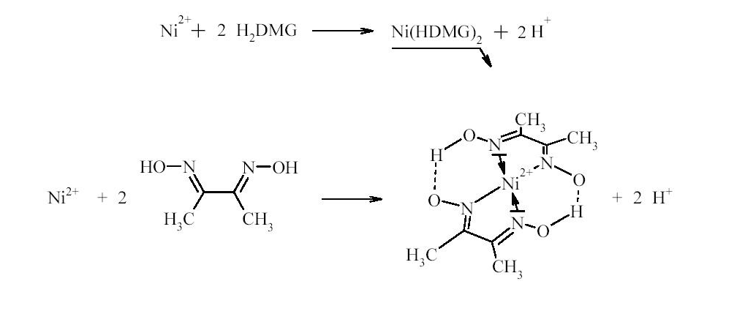
organic precipitation agents
K
Sodiumtetraphenylboron

Slide 11
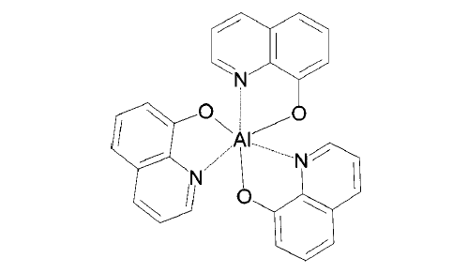
organic precipitation agent
Mg⁺²
+
8-hydroxyquinoline
Al⁺³
+

Slide 12
Gravimetric analysis

Slide 13
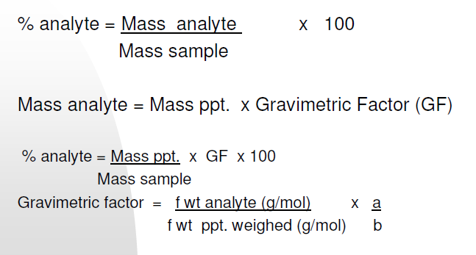
Gravimetric calculation
Gravimetric factor(GF):
the weight of one substance is converted into the corresponding weight of another substance through substance through multiplication by asset of constant terms

Slide 14
Gravimetric factor

Slide 15
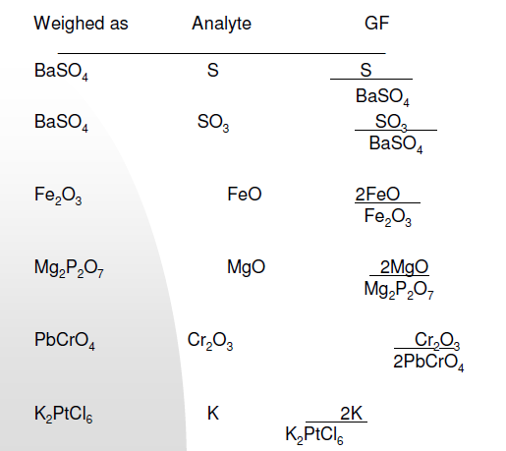
Gravimetric calculation

Slide 16
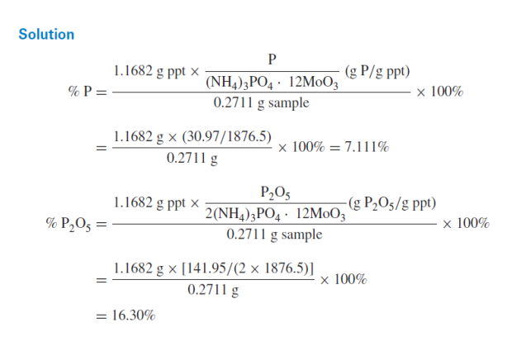
Gravimetric calculation

Slide 17
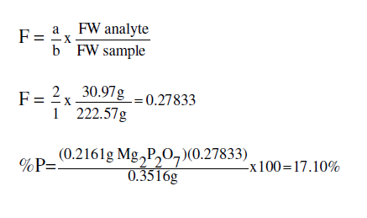
Gravimetric calculation

Slide 18
Solubility
Solubility is defined as the upper limit of solute that can be dissolved in a given amount of solvent at equilibrium.
In such an equilibrium, Le Chatelier's principle can be used to explain most of the main factors that affect solubility.
Le Châtelier's principle dictates that the effect of a stress upon a system in chemical equilibrium can be predicted in that the system tends to shift in such a way as to alleviate that stress.

Slide 19
according to LeChatelier

Slide 20
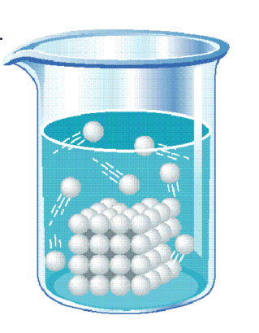
Solubility
Solubility: What is the meaning of solubility ?
The ability of substance to dissolve in a solvent.
Quantity that dissolves to form a saturated solution.
S----- g per 100 mL or g /L
(molar solubility, grams per liter saturated solution.)

Slide 21
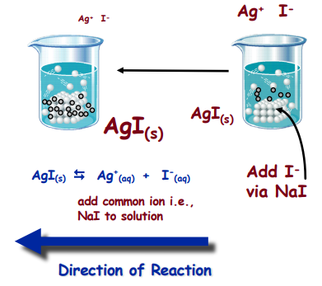
Solubility
For a system containing a precipitate in equilibrium with its ions, solubility of solid can be reduced if an ionic compound is dissolved in the solution.
Reduce solubility i.e.,
less AgI will dissolve in soln’ which
means more ppt. forms in solution

Slide 22
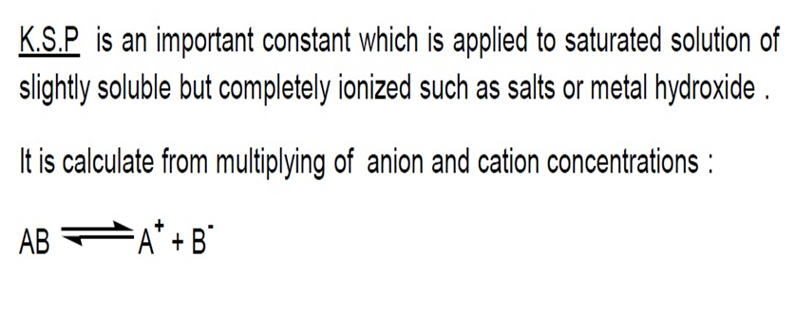
Solubility
solubility product constant Ksp

Slide 23
solubility product constant Ksp
Ksp
Ksp

Slide 24
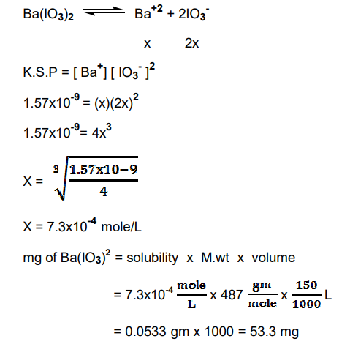
solubility product constant Ksp

Slide 25
Solubility

Slide 26
Solubility

Slide 27
Example :What is the solubility product Ksp, for the following reactions:

Slide 28
Factors Affecting Solubility (s).
Polarity(Nature of Solute )
In most cases solutes dissolve in solvents that have a similar polarity. "Like dissolves like". Non-polar solutes do not dissolve in polar solvents and the other way round.
Temperature Factor
Solids/Liquids- Solubility increases with Temperature (mostly) Increase increases motion and collision between solute / solvent.
gas - Solubility decreases with Temperature Increase. result in gas escaping to atmosphere.

Slide 29
Factors Affecting Solubility (s).
Pressure Factor
Solid and liquid solutes, pressure does not affect solubility.
Gas solutes, Solubility increases with Pressure.
Common ion effect :
in chemical equilibrium , Le Chatelier principle predicted that the solubility of ionized substances or electrolyte is reduce with extent of excess amount of ions that formed the substance in a solution .

Slide 30
Factors effecting the solubility of precipitates
The common ion effect is reduce the solubility of the precipitate.

Slide 31
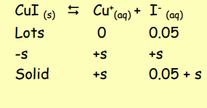
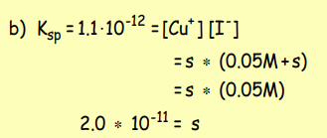
Calculate the solubility of copper(I) iodide, CuI (Ksp = 1.1•10-12) a) water b) 0.05 M sodium iodide

Slide 32
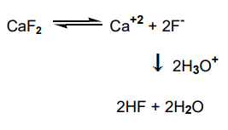
Factors effecting the solubility of precipitates
Effect of hydronium ion concentration (pH) :
Precipitates are effected by hydronium or hydroxyl ion concentration of solvent . There are two types of these effects :
a) when [H3O + ] or [OH- ] is a part of precipitating compound .
Solubility of precipitate will decreasing with increase of [OH- ] concentration.
b) second type is more complicated from the first , when anion or cation of precipitate is capable to react with [H3O + ] or [OH- ] of solvent .

Slide 33
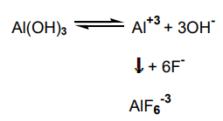
Factors effecting the solubility of precipitates
CaF2 is a salt of a weak acid (HF) , according to Le Chatelier principle , increasing in [H3O + ] concentration causes an increasing in HF concentration and decreasing in F concentration. then , solubility of precipitate will be increase.
Formation of complex ion :
The solubility of precipitate may be greatly altered with presence of some species that forms a soluble complex with anion or cation of the precipitate.

Slide 34
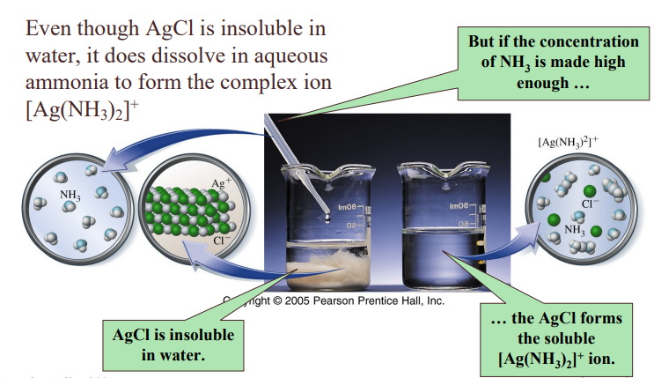
Factors effecting the solubility of precipitates

Slide 35
Factors effecting the solubility of precipitates

Slide 36
Effect of electrolyte concentration on solubility
Note: There are two important generalization to explain the influence of electrolyte concentration on solubility : a) The magnitude of the effect is highly dependent upon the charges of the species involved in the equilibrium.
b) The effect are essentially independent of the kind of electrolyte and dependent only upon concentration parameter of the solution called ionic strength .

Slide 37
Factors effecting the solubility of precipitates

